Slide 1


Production Process : Behaviour of Profit Maximizing Firms
Testing
Milestone
Process
02
01
03
Process
Milestone
Group Items
Launch

Slide 2
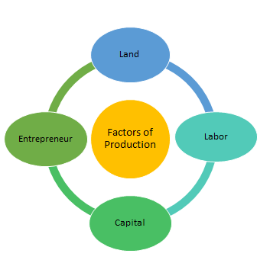
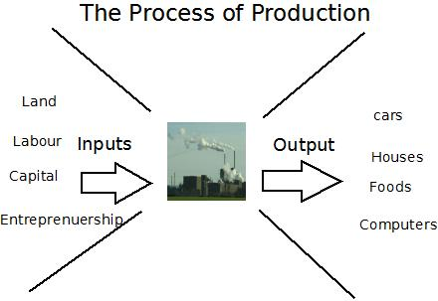
Production Process : Behaviour of Profit Maximizing Firms

Slide 3
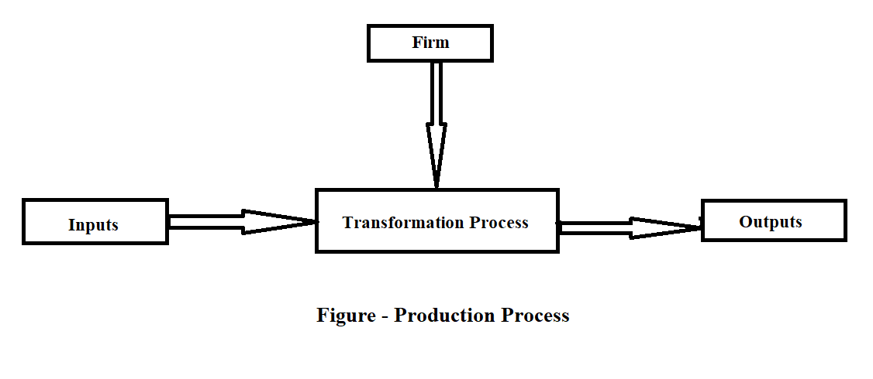
What is Production? Production is a process by which inputs are combined and transformed into outputs of goods and services, for which there is demand.

Slide 4
Three Basic Production Decisions and Behavior of Profit– Maximizing Firms 1. How much output of a product to produce and supply in the market? 2. How to produce the product , that is , which technique or combination of factors of production be used for producing the quantity of product that has been decided to be produced? 3. How much quantity of each input is demanded to produce the output of the product? The above three basic decisions are made with the goal of maximizing profits. Profits = Total Revenue – Total Cost (P = TR – TC )

Slide 5
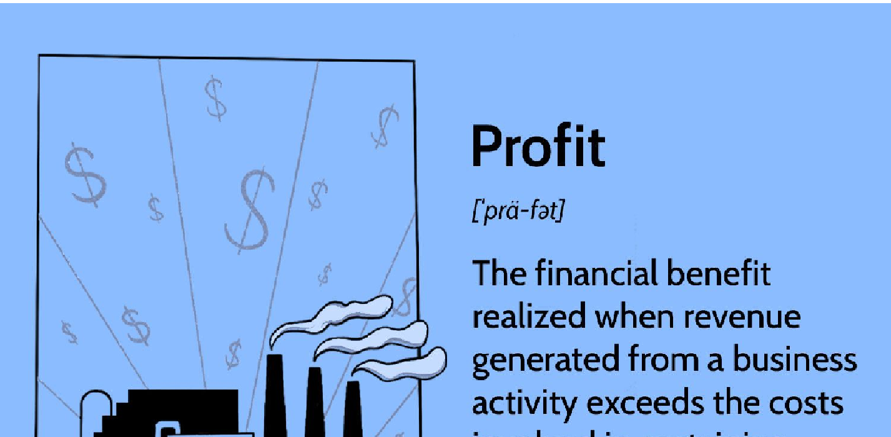
What is Profit?

Slide 6
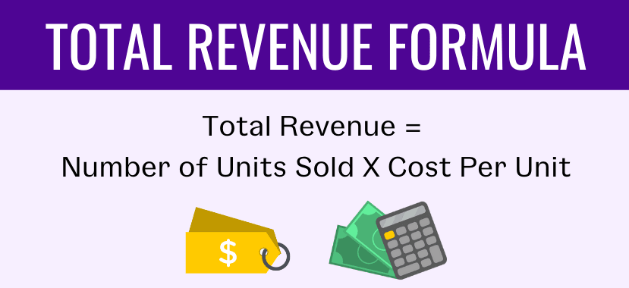
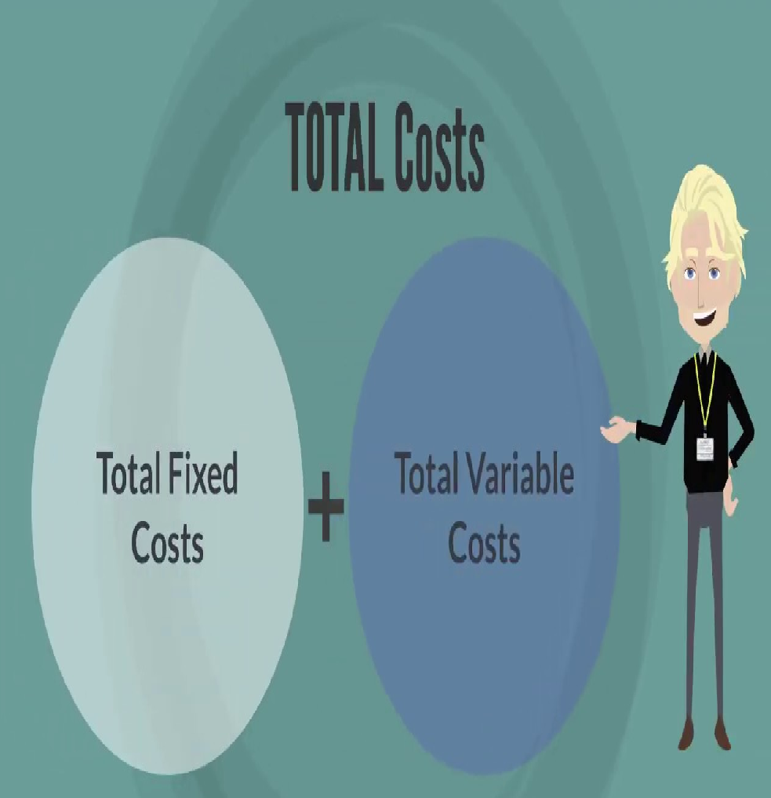
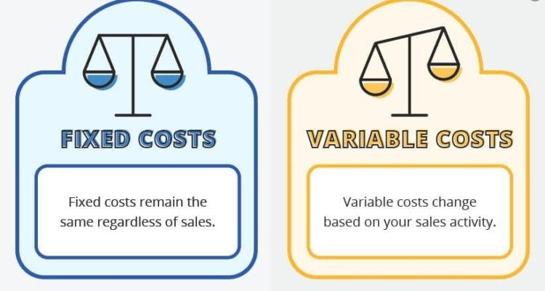
TOTAL REVENUE AND TOTAL COST

Slide 7

What is Firm?
A firm is a business or organization that sells goods or services on a for-profit basis.

Slide 8
Behaviour of Profit Maximizing Firms Profit maximization by a firm is graphically illustrated in figure given where TR represents total revenue curve and TC represents total cost curve. Total revenue curve starts from origin which means that when no output is produced when the total revenue is zero. As output is increased total revenue goes on increasing at a constant rate. Total revenue curve TR is a straight line from the origin. However, it will be noticed that the total cost curve TC starts from a point A which lies above the origin. It means that OA is the fixed cost which the firm has to incur even if it stops production. It will be further seen that TC increases at an increasing rate beyond the break even point C. It will be observed from figure that upto the level OX, TC lies above TR curve showing that as the firm raises its output in the initial stages total cost is greater than total revenue and the firm is incurring loses. When the firm produces OX level of output , total revenue equals total cost and the firm neither making profits nor loses. Thus, point C or output level OX is called break-even point. When the firm increases its output beyond OX total revenue becomes larger than total cost and therefore profits begin accrue to the firm. It will be noticed from the figure that profits are increasing as the firm increases production to output OY, since the distance between the TR and TC curves is widening. At OY capital of output the distance between TR and TC curves is the greatest and therefore profits will be maximum. If the firm expands output beyond OY, the gap between TR and TC goes on narrowing down and therefore the total profits are declining. Its is therefore clear that the firm will be maximising profits at OY level of output where total revenue exceeds total cost by the largest amount. It will be observed from the figure that at the output level OZ, total revenue is again equal to the total cost at point D corresponding to output OZ.

Slide 9
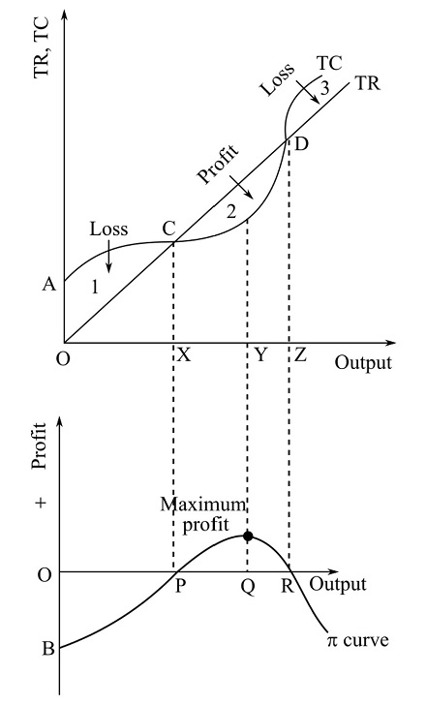

Slide 10
Thus, point D is called as upper break-even point and is not much relevant as it lies beyond firms profit maximising level. In the lower panel of the figure, that up to the output level OP profit curve lies below x-axis making losses. At output level P the firms profit is zero. Profit curve is rising until it reaches its maximum point corresponding to the level of output Q. Beyond level of output Q profit curve slopes downward indicating that profits decline beyond Q. At point Q the firm maximises economic profits. At a higher level output R , profits are again zero indicating the upper break-even point. Hence, this way a firm maximizes its profit.

